Slide 1


Lemon
Smart Campus Lost-and-Found System
Centralizing Campus Discovery, Accelerating Recovery, and Protecting Student Privacy

Slide 2
Meet the Team
The Minds Behind Lemon
A multidisciplinary team of ICT105 students combining product strategy, technical engineering, UX design, and documentation to deliver a privacy-first campus lost-and-found system.
Kyaw Ye Lin
Phollapat Rodchue
Product Lead
Technical Lead
Tin May Lin
Phoochit Jantakam
UX/UI Lead
Documentation Lead

Slide 3


The Campus Lost-and-Found Crisis
Fragmented, Inefficient, and Frustrating for Everyone
Lost item reports are scattered across LINE groups, Discord servers, and Facebook posts — with no central system. 65% of students abandon their search within 24 hours. Students lose IDs, calculators, USBs, and access cards daily, while campus security staff are overwhelmed by manual logs and constant inquiries.

Slide 4




Evidence-Based Validation
Discovery Insights & User Research Findings
15 structured user interviews with students and staff confirmed that fragmented workarounds cause significant delays in recovering lost items on campus.
User Interviews
Task Completion Rate
15 structured interviews conducted. 100% of participants confirmed delays caused by scattered reporting workarounds.
80% task completion rate achieved in prototype v1 testing with 20 users (16/20 tasks completed successfully).
Usefulness Score
Key Iteration
System usefulness rated 4.35/5.0 and user interest scored 3.80/5 across all prototype testers.
Replaced text status labels with color-coded badges: Pending Review, Available, Claimed, and Closed.

Slide 5

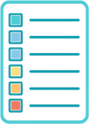


Lemon — Our Solution
Centralized, Privacy-First Lost-and-Found Platform
Lemon replaces fragmented chat groups and manual logs with a single, secure, browser-based system — no hardware required, fully accessible on mobile and desktop.
Centralized Discovery Engine
Privacy-First Protection
Single searchable database with multi-criteria filters for fast item recovery.
Masked Student IDs and emails protect user identity at all times.
Streamlined Admin Workflow
Zero-Hardware Deployment
Color-coded status badges (Pending, Available, Claimed, Closed) streamline staff case tracking.
Fully functional on any mobile or desktop browser — no sensors or special hardware needed.

Slide 6
Live Prototype Demonstration
5-Step User Journey Walkthrough — Lemon System
Each step guides users from discovery to claim resolution through a seamless, privacy-protected web interface accessible on mobile and desktop browsers.
Step
Page / Module
Function
Landing Gateway
(index.html)
Step 1
Hero search bar + CTAs
Step 2
Report Filing
(form.html)
Validated submission form
Step 3
Search & Catalog
(records.html)
Filters + status badges
Step 4
Item Detail & Claim
(detail.html)
Masked contact + claim
Step 5
Admin & Analytics
(admin.html & dashboard.html)
Staff console: review claims,
update status, view metrics

Slide 7
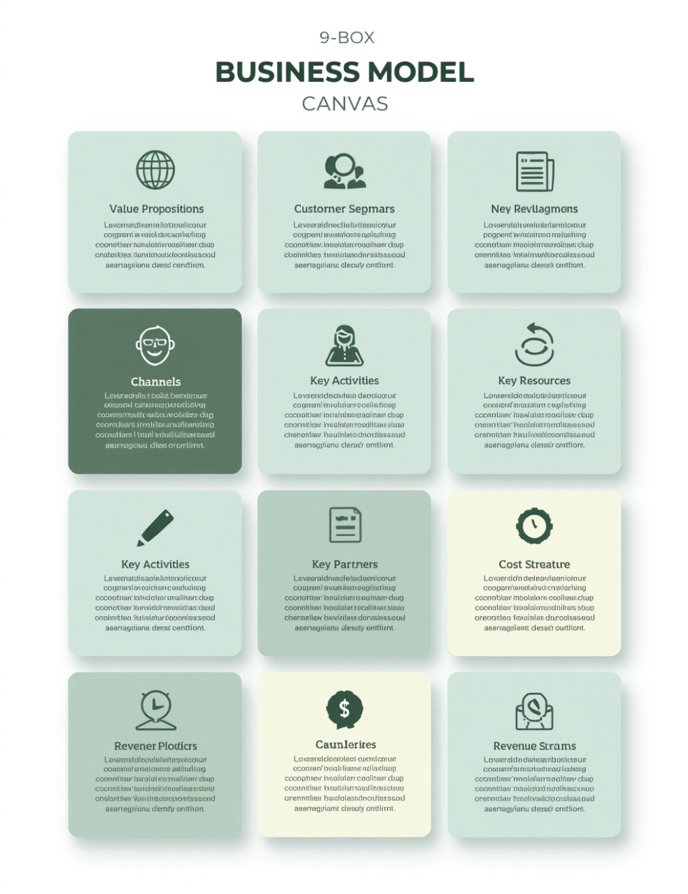
Business Model Canvas & Operational Logic
How Lemon Creates & Delivers Value
Value Prop : Centralized, privacy-first lost-and-found management.
Segments. : Students (finders & losers) + campus security & staff.
Channels : Web browser, university portal, QR codes, LINE/Discord.
Activities : Portal maintenance, claim verification, UX refinement.
Resources : Dev team, web stack, JSON storage, GitHub, university server.
Partners : University admin, security office, student affairs, student body.
Sustainability: Non-commercial — ROI via reduced admin labor & lost property waste.

Slide 8



Product Metrics & Results
Digital Acquisition & Usability Performance
Key performance indicators from our live prototype launch, user testing sessions, and digital acquisition funnel — validating real demand and proven usability.
Landing Page Views
CTA Click-Through Rate
365 total views recorded — far exceeding the target of ≥100 views.
41.37% CTR with 151 clicks — strong user intent and engagement signal.
Active Testers
Task Completion Rate
48 active testers (13.15% conversion) from 365 landing page visitors.
80% task completion (16/20 users); usefulness score 4.35/5.0.

Slide 9
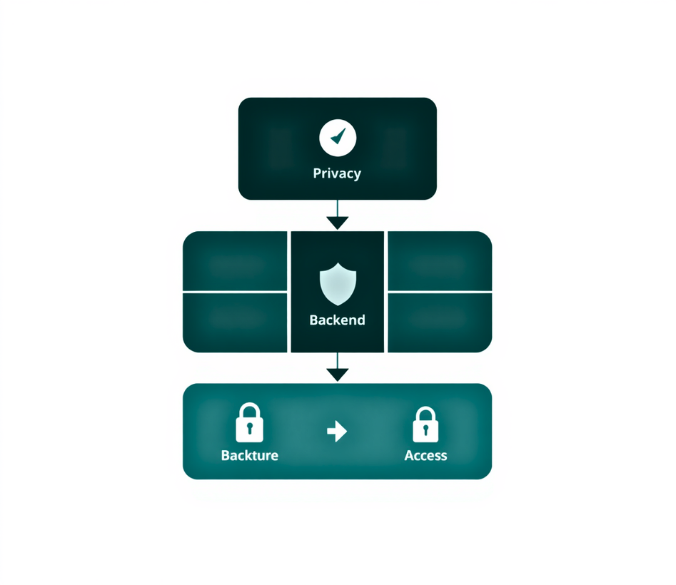
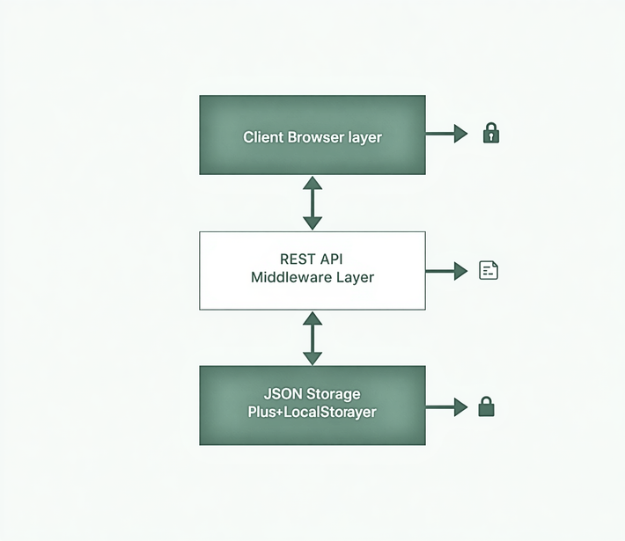
Technical Architecture & Responsible IT Design
Zero-Hardware Stack · Privacy-First · Open-Source Compliant
Frontend. : HTML5, Tailwind CSS, Vanilla JS — responsive across mobile & desktop browsers.
Backend. : Lightweight Express.js REST API · JSON file storage · client-side localStorage fallback.
Architecture : Zero-latency queries, offline persistence, clean data/presentation separation.
Responsible IT Principles:
• Data minimization — no sensitive fields collected
• PII protection — masked student IDs & emails (65XXXXX@au.edu)
• Role-based access control — editing restricted to authorized staff
• Open-source compliance: MIT, SIL OFL, Apache 2.0 licenses

Slide 10
Product Iterations & Future Roadmap
From MVP to Next-Generation Campus Recovery Platform
Lemon has completed core MVP milestones through iterative testing and is now positioned for advanced feature development and production-scale deployment.
Completed MVP
Improvement Details
Future Roadmap
Mobile Optimization
Nav drawers, stacked hero forms, filter accordions
PostgreSQL / MongoDB
Status Badges
Color-coded Pending, Available, Claimed, Closed
WebSocket Anon Chat
Dashboard Nav
Admin portal access added to all pages
AI Photo Matching
Privacy Masking
Masked Student IDs and emails for privacy
Auth & Role Scaling

Slide 11


Transform Campus Recovery with Lemon
Thank You — Questions & Feedback Welcome
Lemon

